Slide 1

How do global-scale gradients constrain trophic processes?
Notes:
Metabolic hypothesis: temperature should increase consumption rates
Biodiversity hypothesis: Diversity enhances resource use, esp. in heterogeneous environments

Slide 2
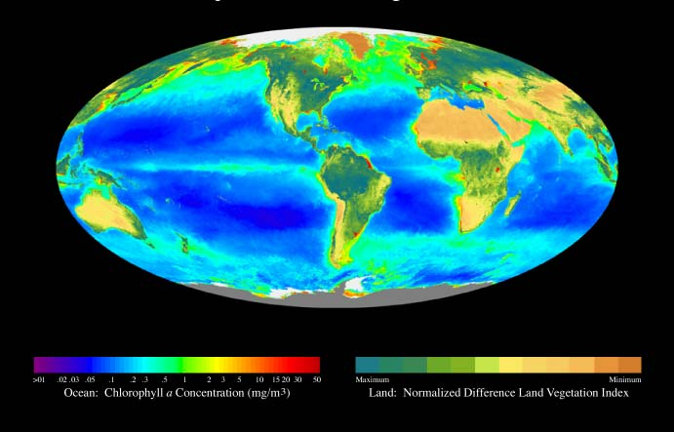
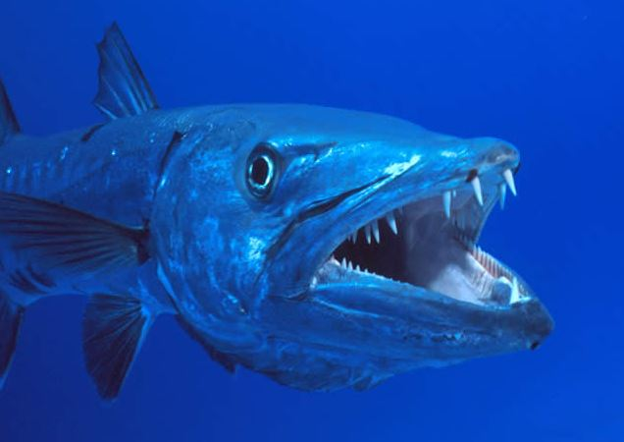
Can we discern a global map of trophic processes?
How do habitat-formers influence local ecological patterns and processes across the globe?
Global primary production
Seagrass biogeographic regions
Short et al. 2007
Notes:
We have lots of useful maps out there and we use these layers to understand patterns on a global scale.
Most maps like this capture abiotic variables or some aspect of ecosystem standing stocks, like static snapshots of biomass
To make predictions about how ecosystems will respond to environmental changes, we need maps of the ecosystem processes that link primary production to production of biomass higher in food webs, and we need standardized experiments to do this

Slide 3
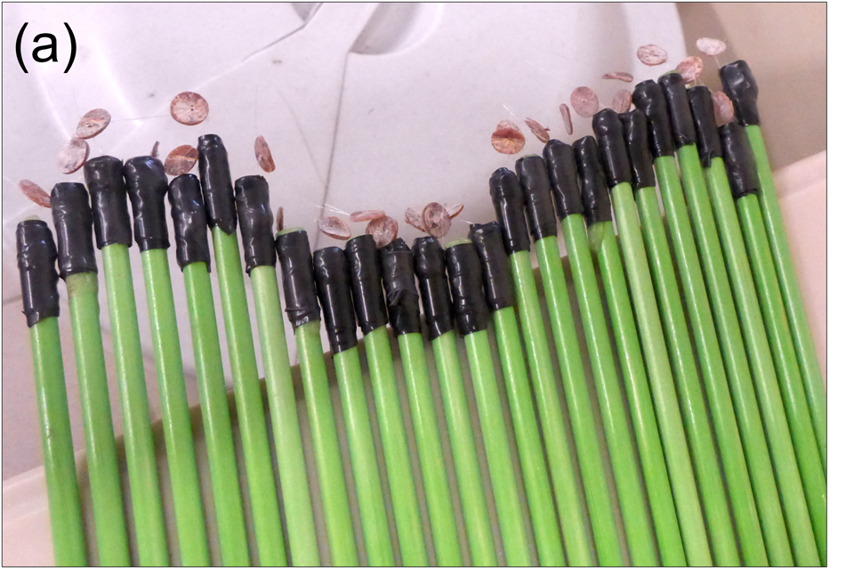
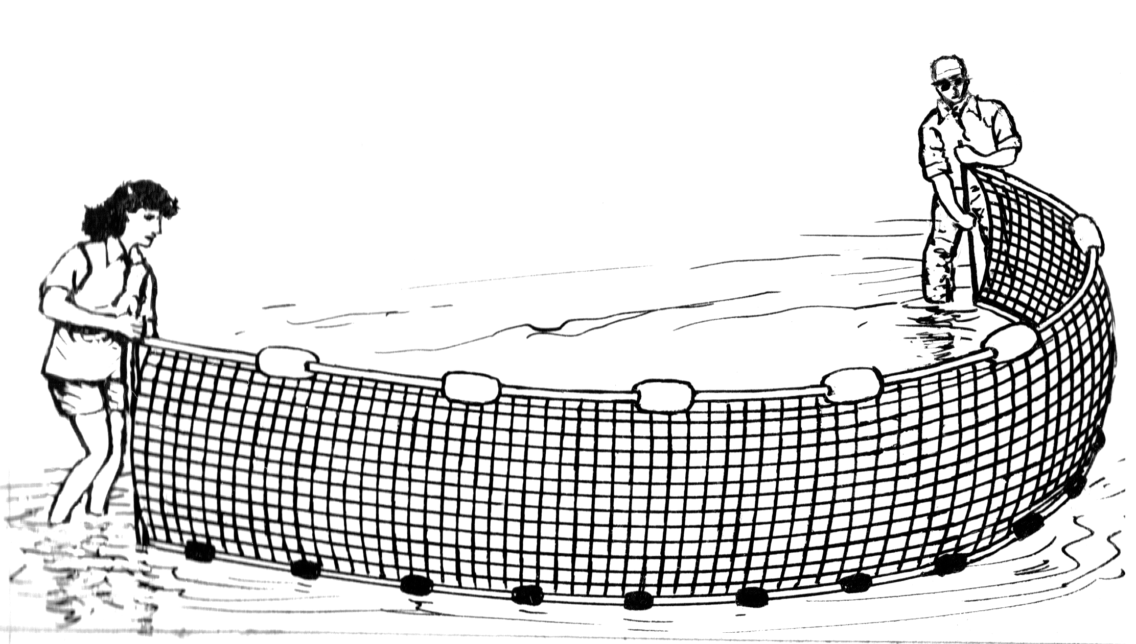
Bitemap: a globally distributed survey of predation in shallow water
Standardized predation assays
“Squidpops” = dried squid on a stick
25 squidpops each in seagrass and unvegetated habitats
seining
predator density, size, biomass, diversity
Methods: Duffy, Ziegler et al 2015, PLoS ONE
Standardized predator surveys
Whalen et al., submitted
Notes:
Standardized assays provide a procedural control we can use to compare across sites

Slide 4
Bitemap: predation across latitude
A
B
C
unrecognized peak in predation intensity at mid latitudes in both hemispheres
Whalen et al., submitted

Slide 5
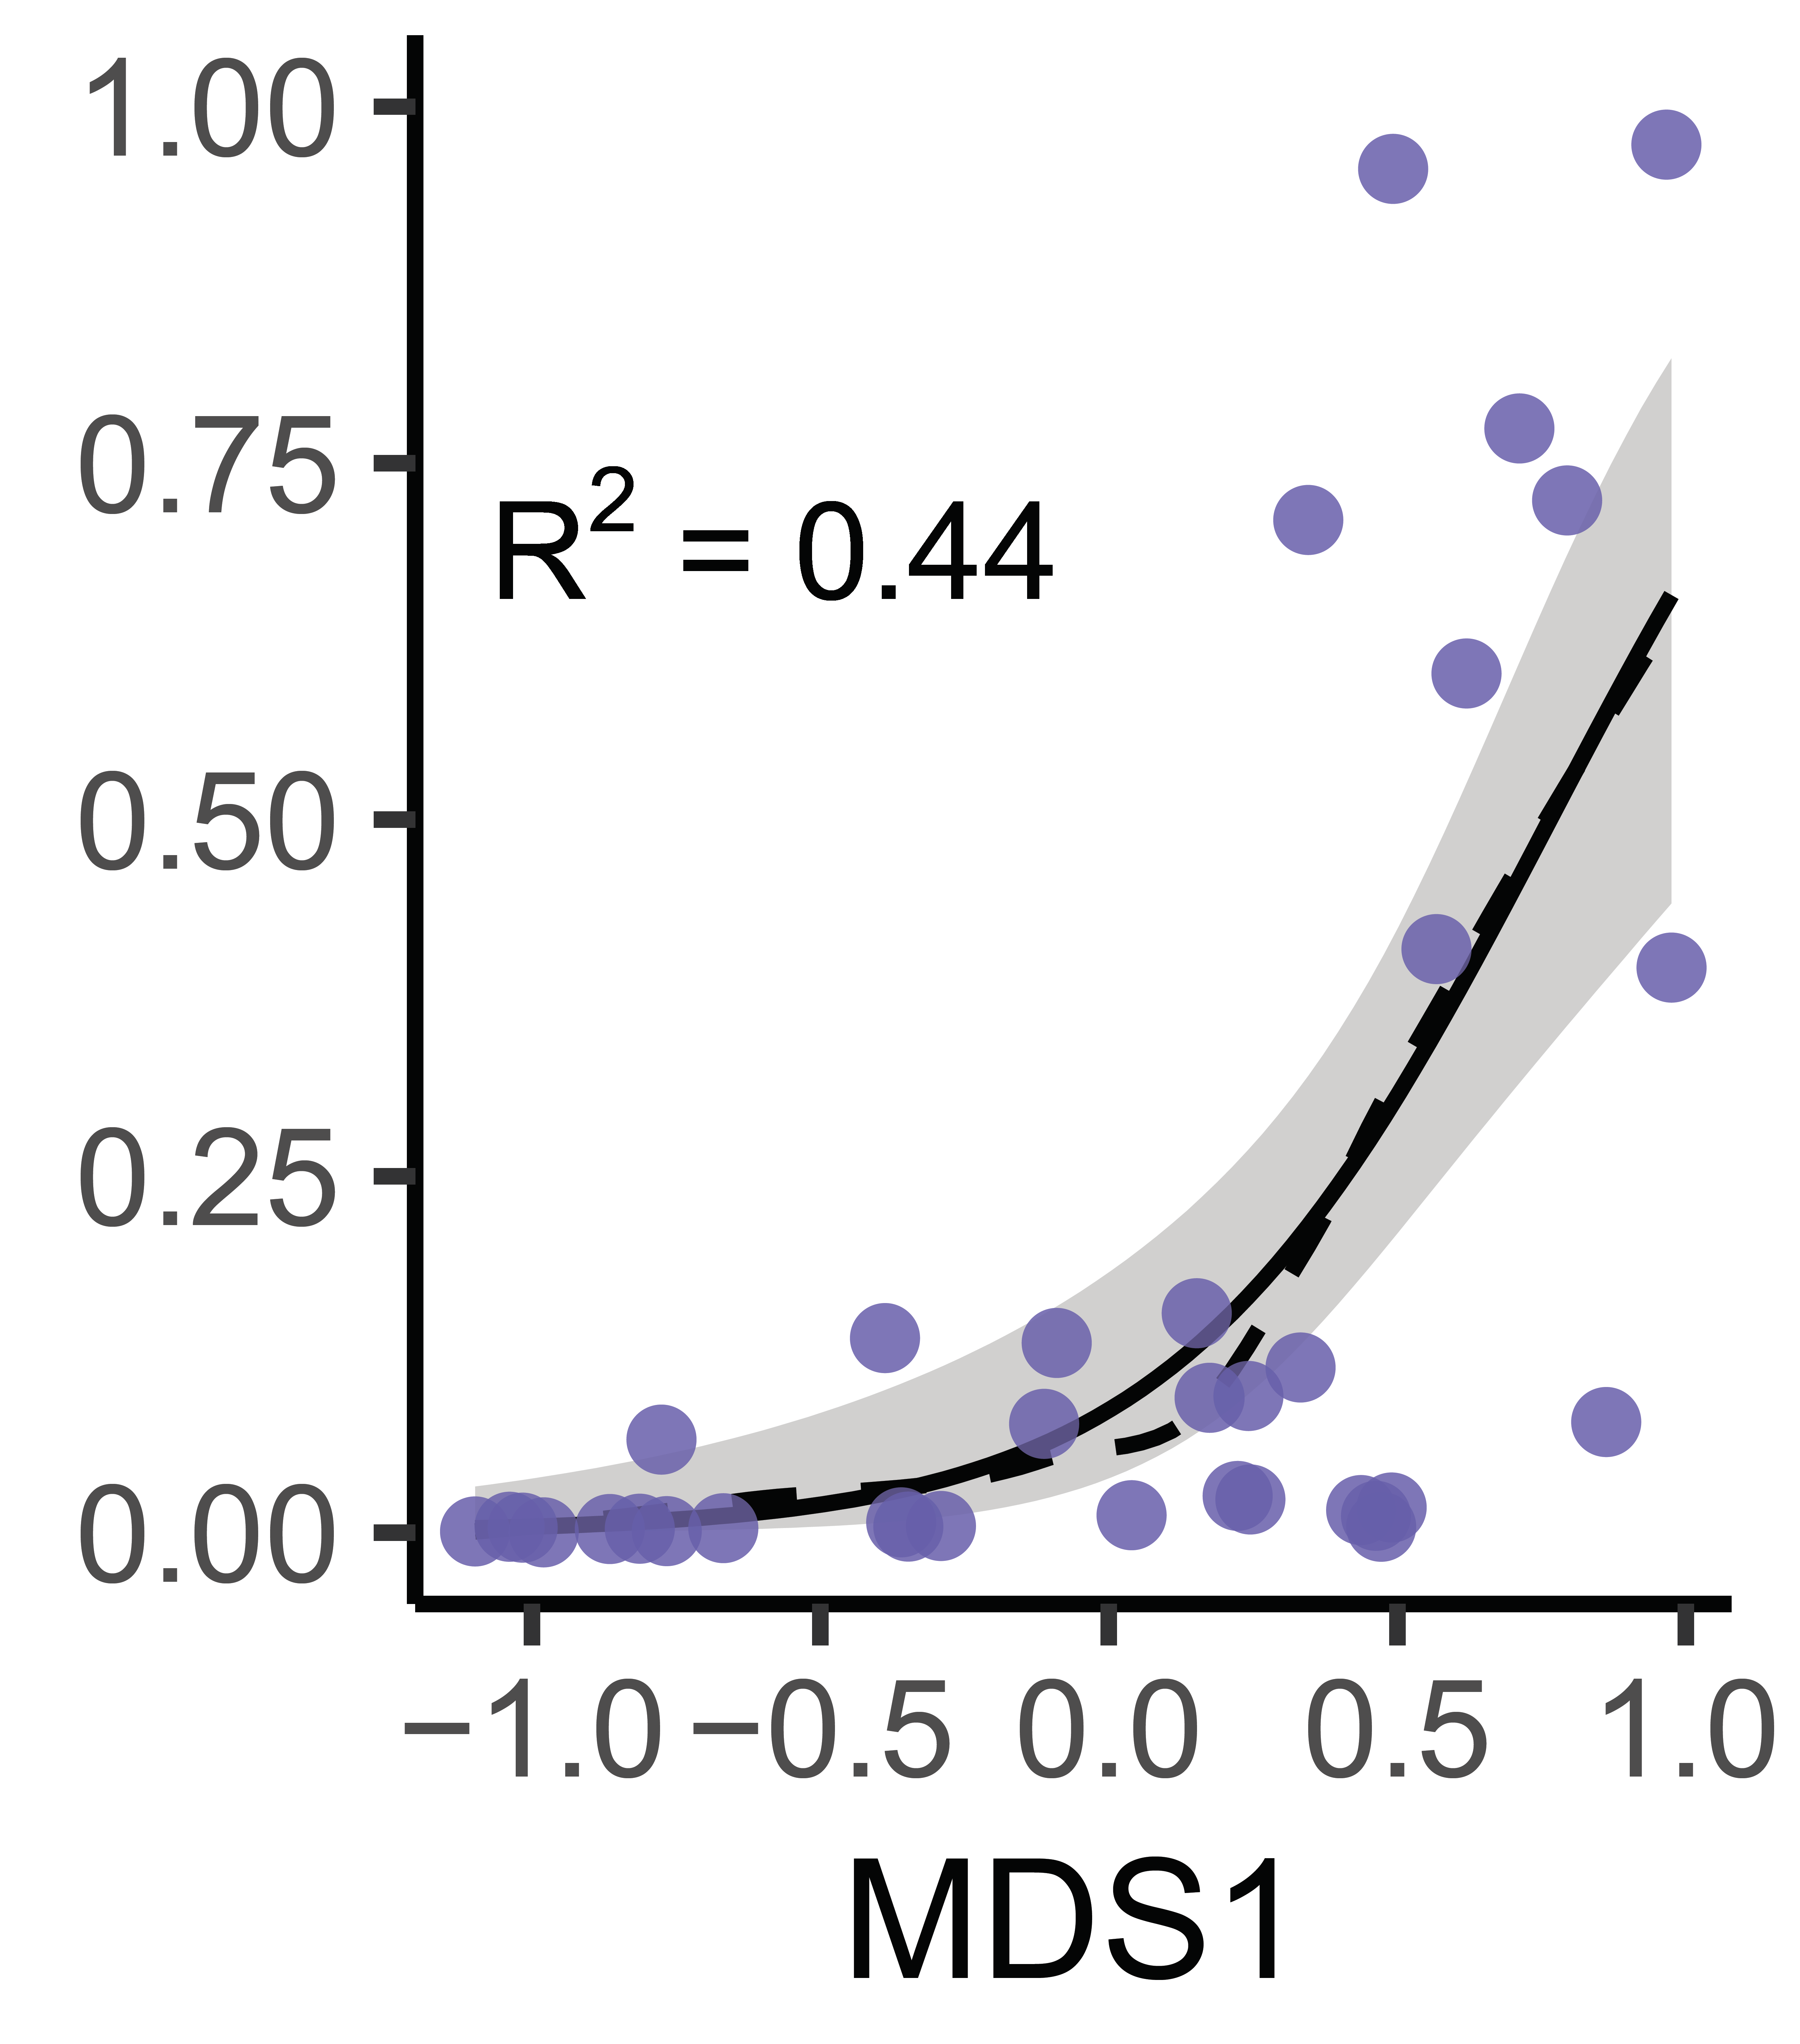
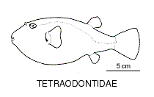
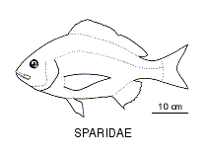
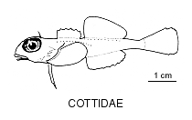
Bitemap: predator composition determines predation intensity
ordination of taxonomic families (presence-absence)
MDS1
MDS2
MDS3
temperature
fish biomass
Whalen et al., in prep
Notes:
Non-metric multidimensional scaling using presence-absence of families across sites: points represent sites in multivariate space. closer together have more similar composition of predator taxonomic families. The size of the symbols corresponds to average predation rate at a site. There is a third axis here, but it doesn’t correspond to predation rate very well as we’ll see in a moment.
Check Stuart-Smith paper for climate shift in composition.
but biotic interactions dictated more by biogeography of predators that the thermal environment, productivity, or habitat type.
This stresses the importance of considering biological variation in addition to environmental variation and climate when managing Earth’s living systems.
As climate changes, how will ecosystems respond? We predict that we may see larger shifts in ecosystem functions with changing biogeography, not just in direct effects of temperature on metabolism

